Slide 1
Toronto Data Analysis
By
Karthikeya Challa

Slide 2
Background
The purpose of this project is to help the people wanting to immigrate to major cities of the world with research on good neighborhoods and ultimately make a smart decision.
It will help people get an awareness on a new city. It will provide a comparative analysis of various neighbor hoods for settlement and opening up a particular business.

Slide 3
Problem Statement
The purpose of this project is to provide information on:
Good neighborhoods with accessible venues
Good secondary school location and information
Good neighborhood to setup a Coffee Shop

Slide 4
Data Section: Web Scrapping
The Toronto neighborhood data is obtained form:
https://en.wikipedia.org/wiki/List_of_postal_codes_of_Canada:_M
The Toronto secondary school data is obtained from:
https://en.wikipedia.org/wiki/List_of_secondary_schools_in_the_Toronto_District_School_Board
Also, the data set with Toronto neighborhood spatial data used in Week 3 Toronto data analysis is also be used.
https://github.com/karthikeyachalla1992/Toronto-Data-Project/blob/master/GC.csv

Slide 5
Data Section: Four Square API
Four Square us a location data provider with information on venues nearby a neighborhood. It provides:
Neighborhood
Neighborhood Latitude
Neighborhood Longitude
Venue
Name of the Venue
Venue latitude
Venue longitude
Venue Category

Slide 6
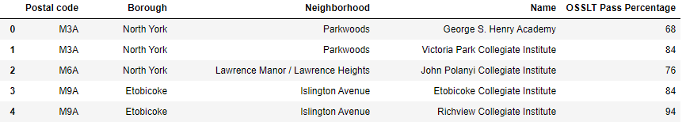
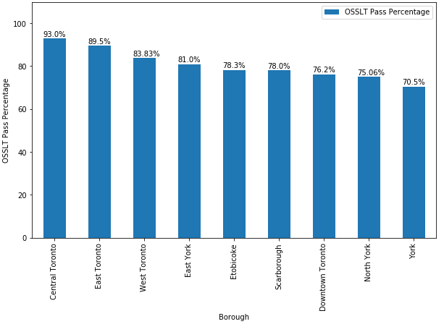
Determining the location to settle
Schools data is analyzed
A bar graph is provided showing the mean pass percentage

Slide 7
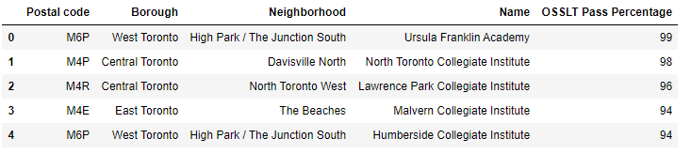
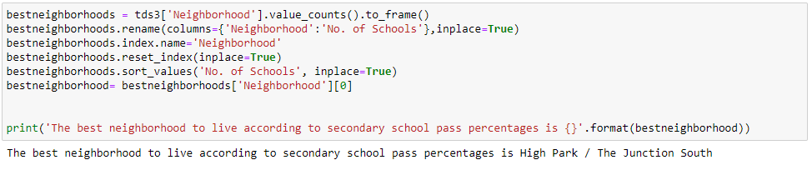
Determining the location to settle
The top 5 schools from top 3 boroughs is tabled
Based on above data analysis the best neighborhood is determined

Slide 8
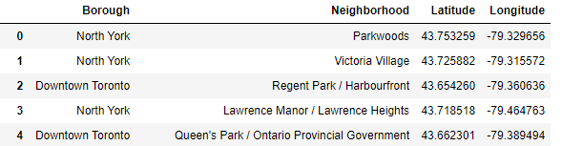
Determining the locations to setup coffee shop business
The CSV file is used to get neighborhood data along with latitude and longitudes

Slide 9
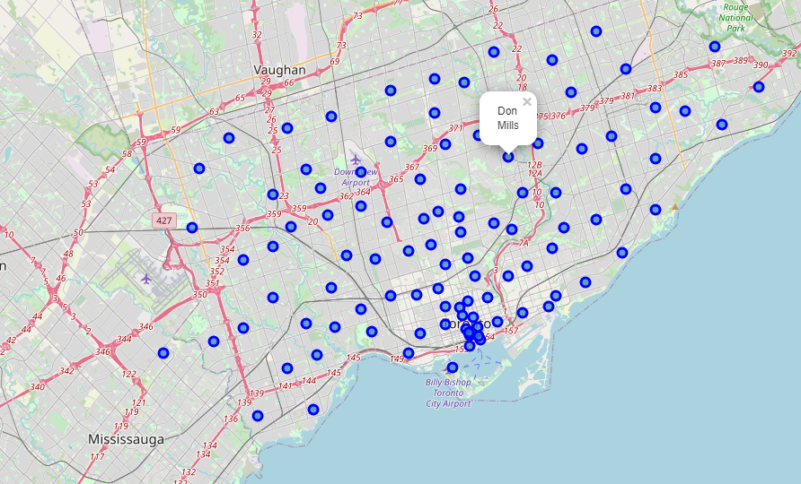
Determining the locations to setup coffee shop business
A map is created to show the neighborhoods in Toronto

Slide 10
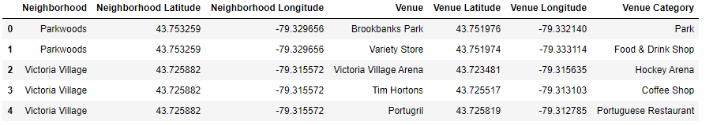
Determining the locations to setup coffee shop business
Forsquare is one of the location data providers. A developer account has been created and credentials have been obtained. Due to a limited number of accesses for this developer account, there will be some restrictions on the radius and count of venues search
Four square API is used to get all the information of venues and locations around neighborhoods

Slide 11
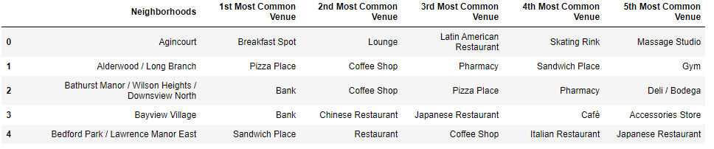
Determining the locations to setup coffee shop business
For each neighborhood the top 5 common venues are provided in the table

Slide 12
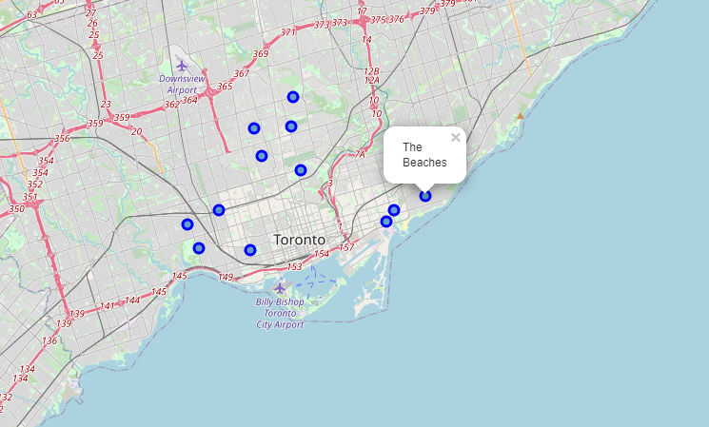
Determining the locations to setup coffee shop business
A map has been created to visualize the best locations for the coffee shop business

Slide 13
K- means Clustering
The similarities or dissimilarities between two neighborhoods in a city could be visualized by segmenting them into various clusters utilizing the k-means clustering machine learning algorithm. So, this project aims at clustering and making sense of data obtained from this clustering technique

Slide 14
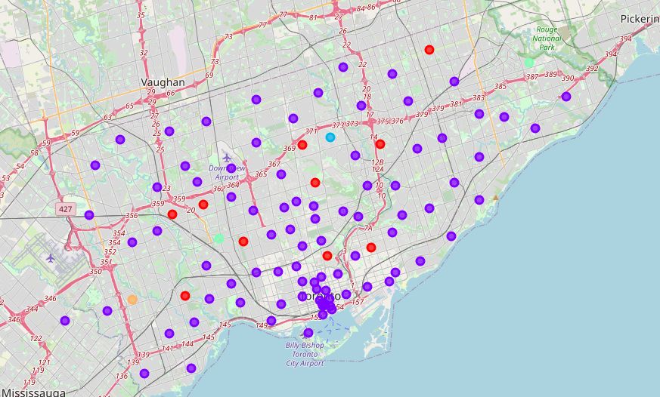
K- means Clustering
A map has been created to visualize the clusters

Slide 15
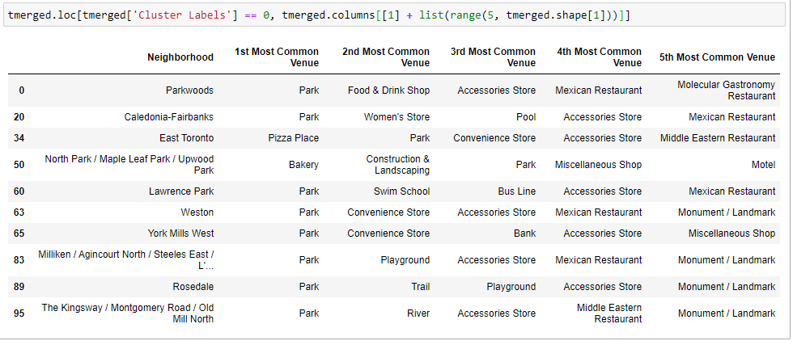
K- means Clustering: Analyzing
Cluster 0 represents the neighborhoods with Park as their 1st most common venue.

Slide 16
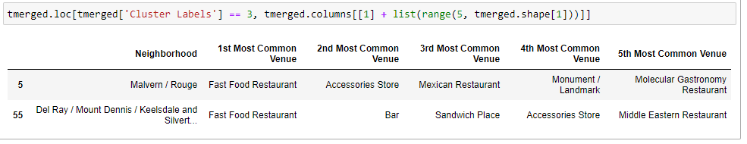
K- means Clustering: Analyzing
Cluster 2 represents the neighborhoods with Park as their 1st most common venue.

Slide 17
Conclusion
The Toronto neighborhood data and secondary school data retrieved from the wiki pages have been analyzed and presented in the form of tables and maps for an immigrant to choose the place to live and setup a coffee shop business.

